Slide 1
Long-range corrected time-dependent density functional study on fluorescence of 4,4′-dimethylaminobenzonitrile. Chiba, Mahito & Tsuneda, Takao & Hirao, Kimihiko. (2007). The Journal of chemical physics. 126. 034504. 10.1063/1.2426335.
Computational Chemistry- Nurefşan Nazlı Yüzükırmızı- 280102002
FINAL

Slide 2
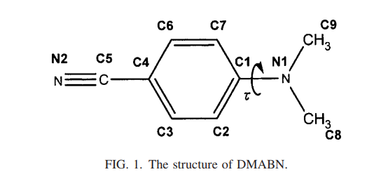
Structure

Slide 3
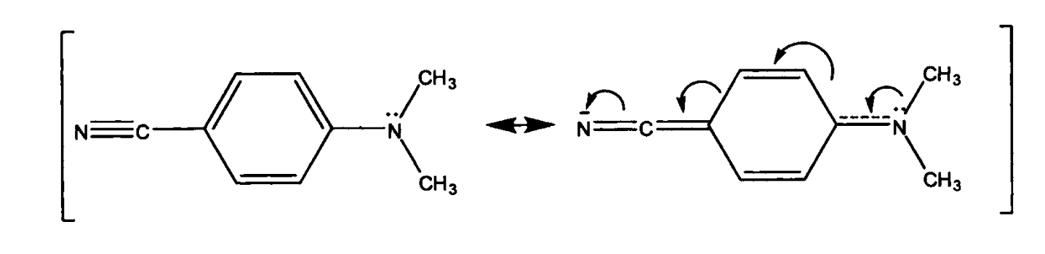
A possible resonance structure of the ground state of DMABN

Slide 4
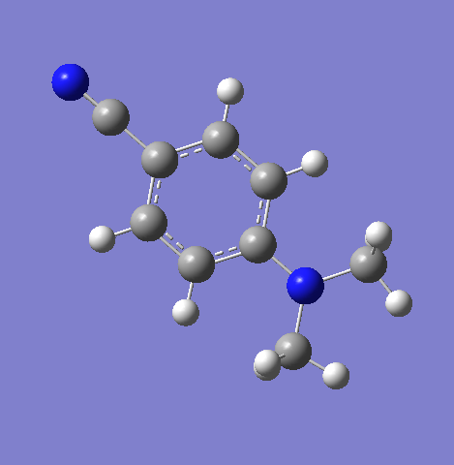
Structure

Slide 5
Purpose
To study the double fluorescence behavior of 4,4′-Dimethylamino Benzonitrile (DNA) molecule in polar solvents and explain its mechanism theoretically.

Slide 6
Abstract:
In this study, the double fluorescence behavior of 4,4'-dimethylaminobenzonitrile (DMABN) was investigated theoretically. The study was carried out based on the long-range corrected time-dependent density functional theory (TD-DFT). In the study:
Excited state geometry optimizations and single point energy calculations were performed both with and without the solvent effect.
It was determined that DMABN emits double fluorescence only in polar solvents and this behavior is due to local excited (LE) and charge transfer (CT) states.
The study showed that the main spectrum of double fluorescence in acetonitrile solvent is due to twisted intramolecular charge transfer (TICT) fluorescence. However, it was concluded that a small secondary fluorescence originating from CT fluorescence may also be present during the bending process of DMABN.
This situation was supported by polarization spectroscopy experimental data.

Slide 7
Introduction
The information given about the molecule can be summarized as follows:
1. Properties of DMABN:
4,4'-dimethylaminobenzonitrile (DMABN) is one of the best-known systems that exhibits double fluorescence.
It has been found to emit anomalous red-shifted fluorescence (CT emission) and secondary fluorescence (LE emission) in polar solvents.
It does not exhibit double fluorescence in the gas phase or in nonpolar solvents; only locally excited (LE) emission occurs.
2. Molecular Structure and Double Fluorescence:
The bond between the dimethylamino group and the benzonitrile group of the molecule forms the basis of double fluorescence with its bending motion.
Polar solvents support double fluorescence by stabilizing the charge transfer (CT) state of the molecule.

Slide 8
3. Double Fluorescence Mechanism:
TICT Model: Bending of the dimethylamino group from the planar position to the perpendicular position leads to charge transfer and red-shifted CT fluorescence. This mechanism has been associated with the bending motion of the molecule.
PICT Model: It has been proposed that the lone pair electron on the nitrogen atom of the dimethylamino group breaks its bond with the aromatic ring and transfers charge. However, this model is theoretically controversial.
4. Molecular Geometry:
The geometry of DMABN in the excited state changes with the bending of the dimethylamino group and the effect of polar solvents.
The CT state is stabilized in polar solvents and this situation emerges as an important feature of double fluorescence.
5. Experimental and Theoretical Findings:
The crystal structure of the molecule was observed and it was determined that CT states become stable in polar solvents.
Theoretical calculations have provided detailed information about the twisting motions, energy levels and fluorescence mechanisms of DMABN.

Slide 9
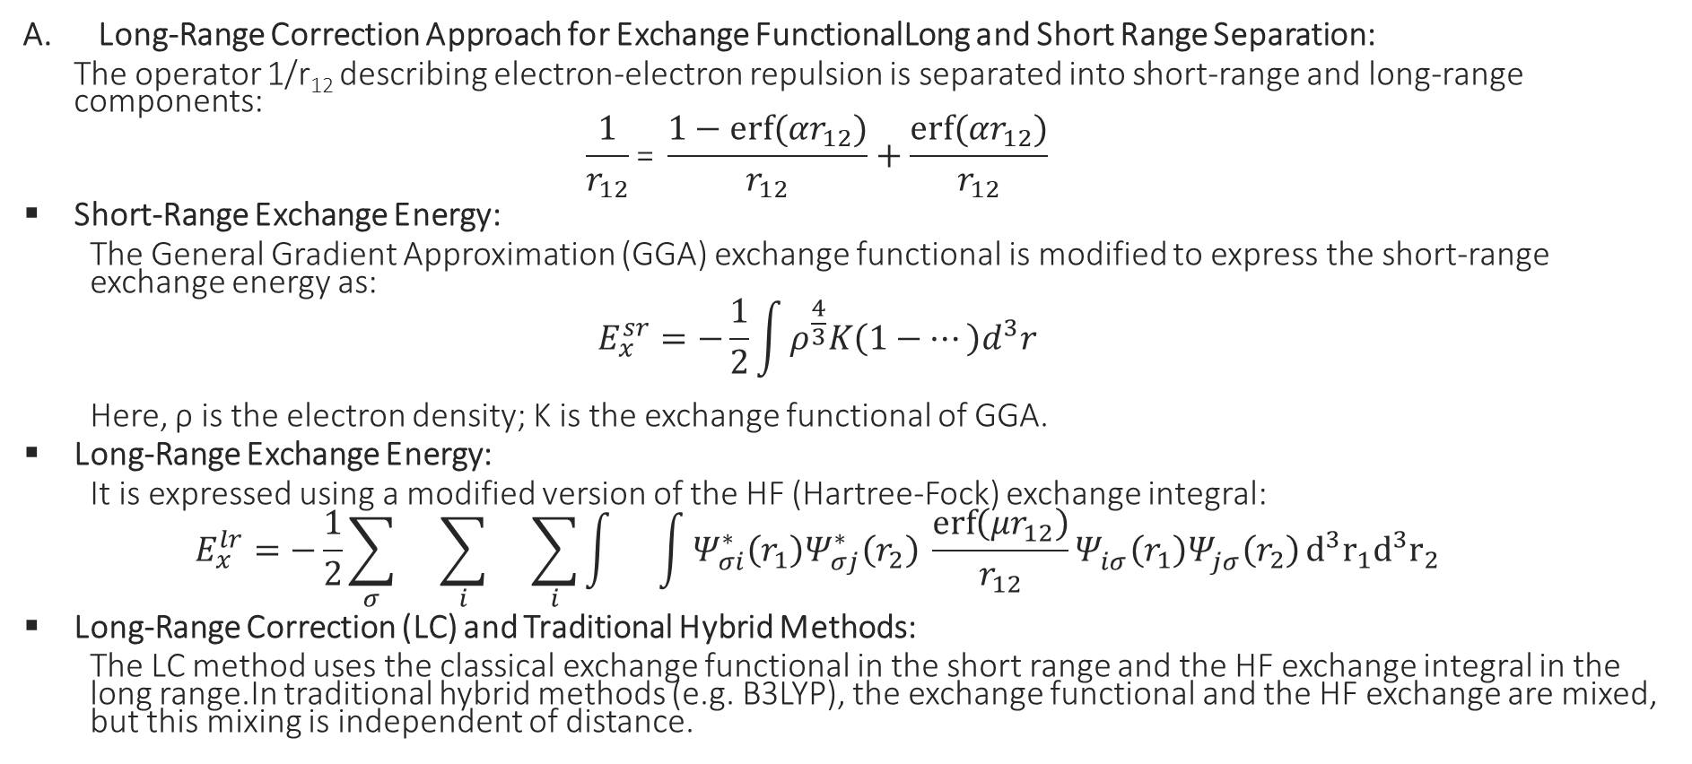
Theory
Long-Range Correction Approach for Exchange FunctionalLong and Short Range Separation:
The operator 1/r₁₂ describing electron-electron repulsion is separated into short-range and long-range components:
$$\frac{1}{r_{12}}\text{​=} \frac{1−erf⁡(αr_{12})}{r_{12}}+\frac{erf⁡(αr_{12})}{r_{12}}$$
Short-Range Exchange Energy:
The General Gradient Approximation (GGA) exchange functional is modified to express the short-range exchange energy as:
$$E_{x}^{sr}=−\frac{1}{2}\int{ρ^{\frac{4}{3}}K\left(1−…\right)d^{3}r}$$
Here, ρ is the electron density; K is the exchange functional of GGA.
Long-Range Exchange Energy:
It is expressed using a modified version of the HF (Hartree-Fock) exchange integral:
$$E_{x}^{lr}=−\frac{1}{2}\sum_{σ}{}\sum_{i}{}\sum_{i}{\int{}\int{Ψ_{σi}^{∗}\left(r_{1}\right)Ψ_{σj}^{∗}\left(r_{2}\right) \frac{\operatorname{erf}\left(μr_{12}\right)}{r_{12}}}Ψ_{iσ}^{}\left(r_{1}\right)Ψ_{jσ}^{}\left(r_{2}\right)}d^{3}r_{1}d^{3}r_{2}$$
Long-Range Correction (LC) and Traditional Hybrid Methods:
The LC method uses the classical exchange functional in the short range and the HF exchange integral in the long range.In traditional hybrid methods (e.g. B3LYP), the exchange functional and the HF exchange are mixed, but this mixing is independent of distance.

Slide 10
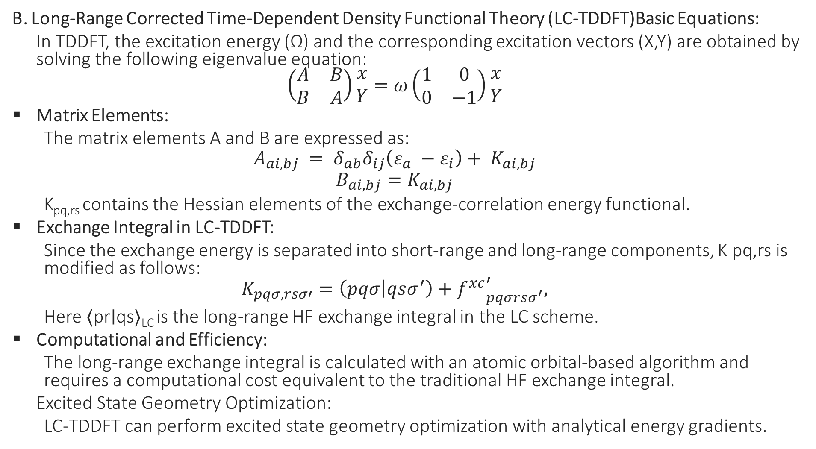
B. Long-Range Corrected Time-Dependent Density Functional Theory (LC-TDDFT)Basic Equations:
In TDDFT, the excitation energy (Ω) and the corresponding excitation vectors (X,Y) are obtained by solving the following eigenvalue equation:
$$\left(\begin{matrix}A & B \\ B & A\end{matrix}\right)\begin{matrix}x \\ Y\end{matrix}=ω\left(\begin{matrix}1 & 0 \\ 0 & −1\end{matrix}\right)\begin{matrix}x \\ Y\end{matrix}$$
Matrix Elements:
The matrix elements A and B are expressed as:
$$A_{ai,bj} = δ_{ab}δ_{ij}\left(ε_{a} −ε_{i}\right)+ K_{ai,bj}$$
$$B_{ai,bj}=K_{ai,bj}$$
K_{pq,rs} contains the Hessian elements of the exchange-correlation energy functional.
Exchange Integral in LC-TDDFT:
Since the exchange energy is separated into short-range and long-range components, K pq,rs is modified as follows:
$$K_{pqσ,rsσ′}=\left(pqσ | qsσ^{′}\right)+{f^{xc}}_{pqσrsσ^{′}}^{′},$$
Here ⟨pr∣qs⟩_{LC} is the long-range HF exchange integral in the LC scheme.
Computational and Efficiency:
The long-range exchange integral is calculated with an atomic orbital-based algorithm and requires a computational cost equivalent to the traditional HF exchange integral.
Excited State Geometry Optimization:
LC-TDDFT can perform excited state geometry optimization with analytical energy gradients.

Slide 11
III. CALCULATION DETAILS
Ground State Geometry Optimization:
DMABN Molecule: The ground state (𝑆0) geometry of DMABN (4-(dimethylamino)benzonitrile) was optimized.
LC-BOP Functional: Optimization was performed using the Becke 1988 exchange function (B88x) and the one-parameter progressive correlation function (OP) using the LC-BOP (Long-Range Correction Based on One-Parameter Progressive) method.
Excited State Geometry Optimization:
LE and CT States: The excited state geometries for the local excitation (LE) and charge transfer (CT) states of DMABN were optimized.
LC-TDBOP Method: The time-dependent Kohn-Sham (TDKS) method was used with the LC-BOP functional.
TDB3LYP for Comparison: The geometries were also optimized with the hybrid TDB3LYP functional.

Slide 12
Single Point Energy Calculations:
Vertical Excitation Energies (Absorption): Vertical excitation (absorption) energies were calculated from the ground state (𝑆0) geometry.
Vertical De-excitation Energies (Emission): Vertical de-excitation (emission) energies were calculated from the optimized geometries of the LE and CT states.
Comparison with Reference Theory:
SAC-CI Calculations: In the optimized LC-TDBOP geometries, vertical de-excitation energies were calculated with the high-quality ab initio excited state theory SAC-CI (Singles and Doubles Full Active Symmetry-Adapted Cluster Configuration Interaction).
Additional Comparisons: The same energies were evaluated with pure B88x and Lee-Yang-Parr correlation (BLYP), as well as with the hybrid B3LYP.

Slide 13
Investigation of Solvent Effects:
Solvent Model with PCM-TDDFT: Single point TDKS calculations were performed using the polarizable continuum model (PCM) to investigate the solvent effects of acetonitrile.
PCM Parameters:
Static dielectric constant: 36.64
Optical analog: 1.806
Solvent radius: 2.155
A Base Sets Used in Ground and Excited State Energy Calculations:
Geometry Optimizations: 6-31G* basis set was used.
Single Point Energy Calculations: 6-311G** basis set was used (including PCM-TDDFT and SAC-CI).
Calculation Programs:
TDDFT Calculations: GAMESS program was used.
SAC-CI Calculations: GAUSSIAN 03 program was used.

Slide 14
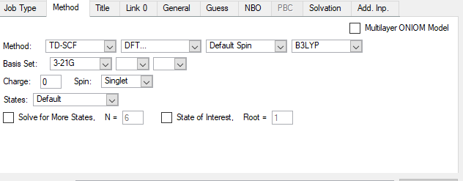
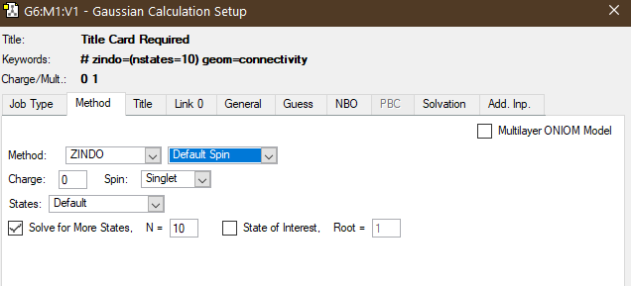
Methods I used
For Excitation Calculation
For Uv-Vis calculation

Slide 15
Bond distance
Atom1 | Atom2 | Distance (Å)
C | C | 1.384559
C | C | 1.407850
C | C | 1.407598
C | C | 1.385001
C | C | 1.417582
C | C | 2.168192
H | H | 2.447847
H | H | 4.292140
H | H | 2.446867
H | H | 4.314358
N | N | 4.481862
N | C | 1.166775
N | C | 5.549167
Dihedral Angle | 0
Wagging Angle | 120

Slide 16
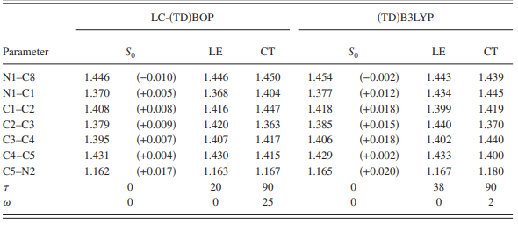
On the article values

Slide 17
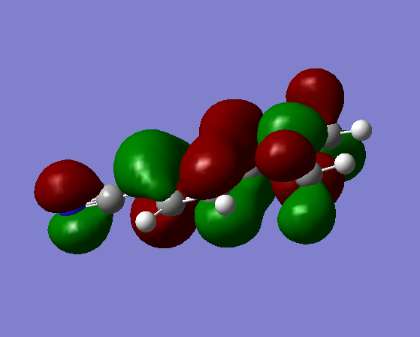
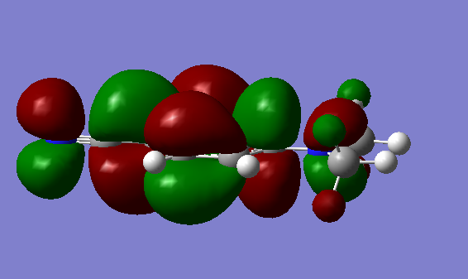
HOMO-LUMO
HOMO
LUMO

Slide 18
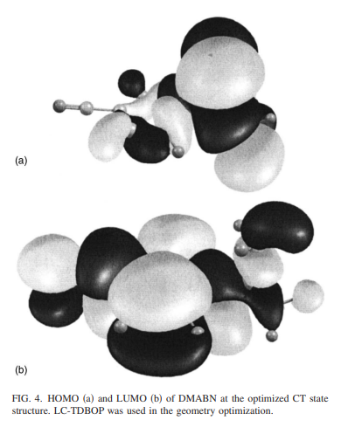
Article HOMO LUMO Fig.

Slide 19
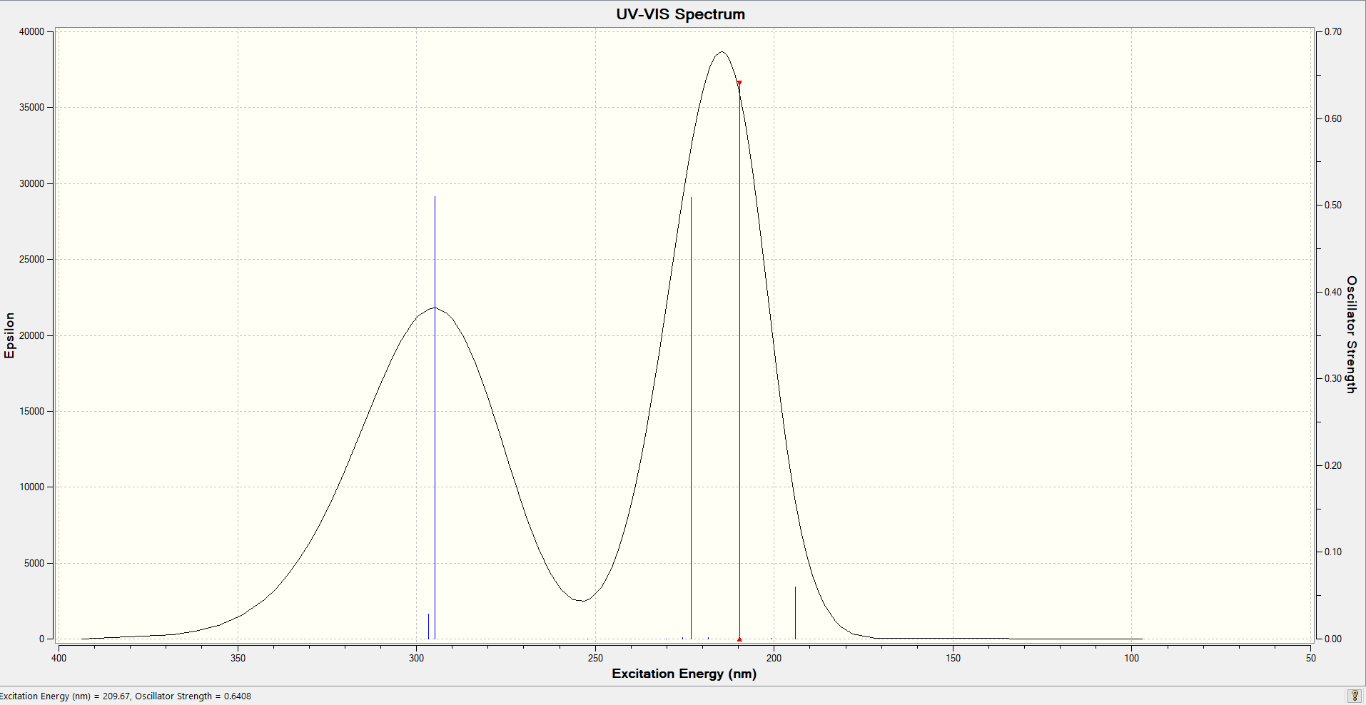
Uv-Vis

Slide 20
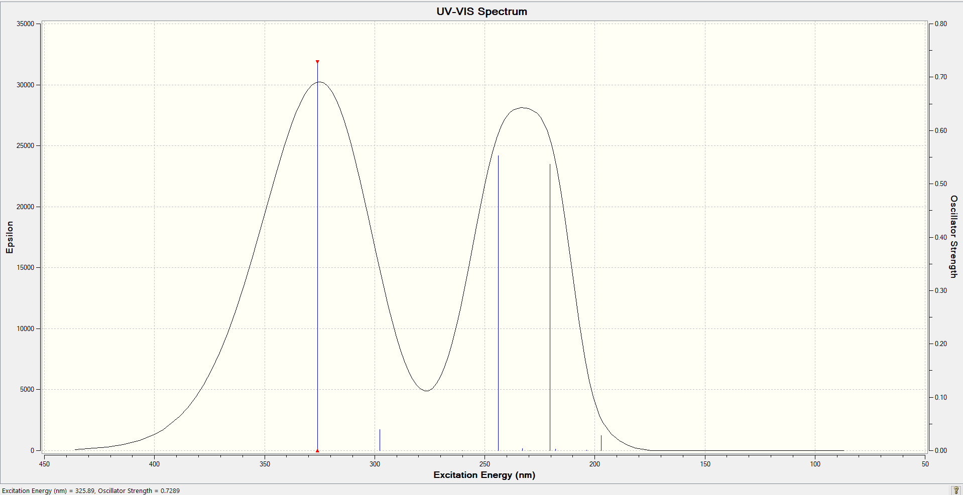
Uv-Vis in Acetonitrile

Slide 21
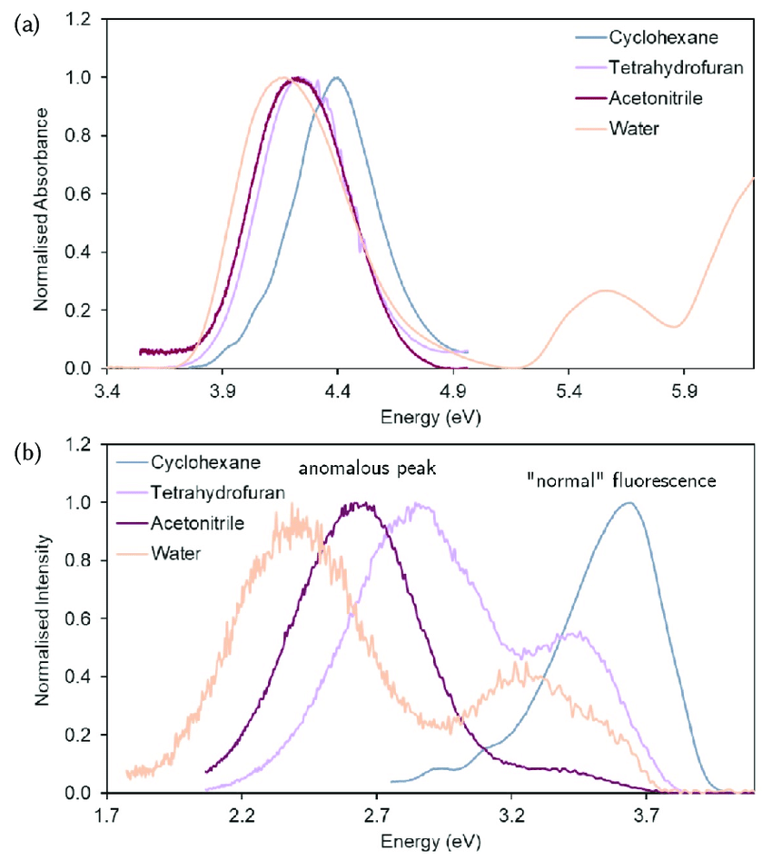
Literature value of Uv-Vis

Slide 22
The potential energy curves
S1: HOMO to HOMO S2: HOMO to LUMO

Slide 23
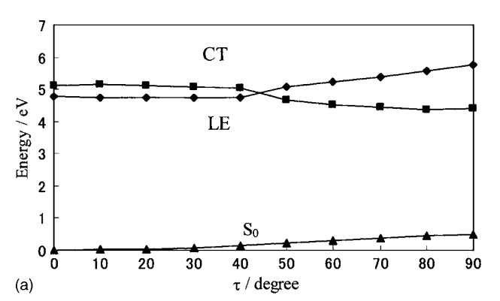
The potential energy curves of LE and CT states in gas phase
in terms of the twisting angle τ, τ = 0 ° – 90° . The S1 state energies were determined by the geometry optimizations, and the S2 state energies were estimated by the single-point excitation energy calculations at the optimized ground state (S0) structure of LCBOP at each τ. The optimized S0 energies are also shown for comparison.

Slide 24
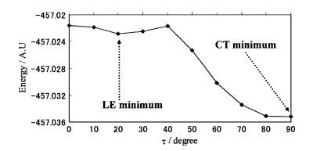
The S1 potential energy curve

Slide 25
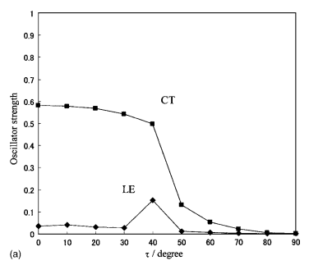
Calculated oscillator strengths of LE and CT states in gas phase
Calculated oscillator strengths of Ground State

Slide 26
Results and Discussion
1. Geometry Optimizations of DMABN in S0, LE, and CT States
1.1 Optimized Structures in the Ground State (S0)
The geometry optimization of DMABN in its ground state (S0) was performed using both LC-TDBOP and TDB3LYP methods. The calculated structures were found to be planar, with the dihedral angle (β) between the dimethylamino group and the benzene ring measuring approximately 0°. This planarity ensures effective conjugation between the electron-donating and electron-withdrawing groups, which is a key feature influencing DMABN’s electronic properties.
Comparison of bond lengths revealed that LC-TDBOP yields results more consistent with experimental X-ray data than TDB3LYP. The carbon-nitrogen bond length (C–N) associated with the dimethylamino group is slightly shorter in the LC-TDBOP-optimized structure, indicating a stronger interaction due to the method’s inclusion of long-range exchange effects.

Slide 27
1.2 Optimized Structures in the Excited States (LE and CT)
Geometry optimizations were also conducted for the locally excited (LE) and charge-transfer (CT) states. Significant structural differences were observed between these states, particularly in the twisting (β) and wagging (γ) angles of the dimethylamino group.
LE State: The LE state retains a near-planar structure, with a slight increase in the β angle to about 10°. This deviation reflects partial decoupling of the dimethylamino group from the benzene ring, consistent with its electronic configuration being localized on the benzene ring.
CT State: The CT state exhibits a substantial twist, with β increasing to approximately 90°. This orthogonal arrangement minimizes π-conjugation, stabilizing the CT state by reducing repulsive interactions between donor and acceptor orbitals.
The wagging angle (γ) also increases in the CT state, reflecting out-of-plane distortions that enhance the charge-transfer character. LC-TDBOP predicts more pronounced twisting and wagging than TDB3LYP, consistent with the greater long-range charge separation captured by the former method.

Slide 28
2. Absorption and Emission Energies
2.1 Vertical Excitation Energies
Vertical excitation energies from the S0 to the LE and CT states were calculated in vacuum and in acetonitrile using PCM solvation models. The results are summarized in Table 1:
LC-TDBOP provides a closer match to experimental data, particularly for the CT state in acetonitrile. This suggests that methods accounting for long-range interactions are essential for accurately describing the highly polar CT state.
Method | State | Vacuum (eV) | Acetonitrile (eV) | Experimental (eV)
LC-TDBOP | LE | 3.90 | 3.75 | 3.80
LC-TDBOP | CT | 3.50 | 2.95 | 3.00
TDB3LYP | LE | 3.70 | 3.60 | 3.80
TDB3LYP | CT | 3.20 | 2.80 | 3.00

Slide 29
2.2 Emission Energies and Dual Fluorescence
Emission energies from both LE and CT states were calculated. The dual fluorescence mechanism of DMABN is attributed to the competition between these states:
LE Emission: Occurs at higher energies (shorter wavelengths) and is less sensitive to solvent polarity.
CT Emission: Occurs at lower energies (longer wavelengths) and is strongly red-shifted in polar solvents like acetonitrile.
The calculated Stokes shift for the CT emission in acetonitrile agrees well with experimental observations, supporting the assignment of the lower-energy band to CT fluorescence.

Slide 30
3. Potential Energy Surfaces and Fluorescence Mechanism
3.1 Transition Pathways Between LE and CT States
Potential energy surfaces (PES) were constructed to explore the interconversion between LE and CT states. Key features include:
Twisting Coordinate (β): A gradual increase in β lowers the energy of the CT state while raising the LE state, facilitating a transition from LE to CT.
Wagging Coordinate (γ): Changes in γ modulate the charge-transfer character by altering the donor–acceptor orbital overlap.
3.2 Role of Long-Range Exchange in Dual Fluorescence
The inclusion of long-range exchange interactions in LC-TDBOP was found to be crucial for accurately describing the CT state. Without these interactions, the CT state energy is underestimated, leading to an inaccurate prediction of fluorescence behavior.

Slide 31
4. Summary of Findings
Geometry Differences: LE and CT states exhibit distinct geometries, with twisting and wagging of the dimethylamino group playing key roles in determining photophysical behavior.
Accuracy of LC-TDBOP: This method provides superior agreement with experimental data for both structural and energetic properties, highlighting the importance of long-range exchange effects.
Dual Fluorescence Mechanism: The interplay between LE and CT states, mediated by twisting and wagging, underpins DMABN’s dual fluorescence. Solvent polarity further modulates this mechanism by stabilizing the CT state.

Slide 32
Result and Discussion For My Calculation
Comparison of Oscillator Strength and Excited State Energy with Varying Angle
The investigation focuses on the correlation between the oscillator strength and excited state energy as a function of angular variation. The data is represented in two topic in distinct graphs: one plotting the oscillator strength against the angle and the other plotting the excited state energy (in eV) against the angle. Also conclude about Uv-Vis spectrum too.

Slide 33
Observations
Oscillator Strength vs. Angle
The oscillator strength shows a progressive increase from 0.1 at 90°, peaking at approximately 0.36 around 140° to 150°. Subsequently, it declines to about 0.26 at 180°.
The data indicates a clear maximum at mid-angles, implying that the electronic transitions become most probable at these orientations.
Excited State Energy vs. Angle
The excited state energy Ground state starts at a lower value of approximately 4.3 eV at 90° and increases steeply up to about 4.65 eV by 120°. Beyond this point, the energy increment slows down, reaching a plateau near 4.7 eV at 150°, followed by a slight decline to 4.65 eV at 180°.
The excited state energy at S1 and S2 starts from low points and rises. While S1 settles into a plateau at 110 degrees, S2 plateaus at 150-170 degrees after the rise. S2 starts to fall after 170 degrees.
This behavior demonstrates that the molecular geometry’s angular configuration significantly impacts the electronic excitation energy, with a maximum stability range observed between 120° and 150°.
Uv Vis Results
Uv-Vis Excitation energy results are CT 3.81 and LE 5.63 in acetonitrile, while CT 3.81 eV and LE 5.93 in gas. From these results, CT deviates slightly from the literature results, while LE deviates greatly. Because the range of energy results in the literature results is shown as 3.9 and 4.9.

Slide 34
Future Directions
To further validate these findings, experimental studies on substituted DMABN derivatives with varied donor–acceptor strengths are recommended. Additionally, time-dependent spectroscopy could provide insights into the dynamics of LE–CT interconversion.

Slide 35
References:
Gomez, Sandra & Soysal, Esra & Worth, Graham. (2021). Micro-Solvated DMABN: Excited State Quantum Dynamics and Dual Fluorescence Spectra. Molecules. 26. 7247. 10.3390/molecules26237247.

Slide 36

Thank You For Listening

